Slide 1
Cryptography and Network Security
RC5

Slide 2
Session Meta Data
Author | Dr T Sree Sharmila
Reviewer
Version Number | 1.0
Release Date | 10 July 2018

Slide 3
Revision History
Revision Date | Details | Version no.
 |  | 1.0

Slide 4
Agenda
Introduction
RC5
Ciphers
Expansion
Encryption & Decryption
Modes
Block & Stream cipher
RC4
Summary
Test your understanding
References

Slide 5
Introduction
can vary key size / input data size / #rounds
very clean and simple design
easy implementation on various CPUs
yet still regarded as secure
Vary parameters to achieve tradeoffs

Slide 6
Agenda
Introduction
RC5
Ciphers
Expansion
Encryption & Decryption
Modes
Block & Stream cipher
RC4
Summary
Test your understanding
References

Slide 7
RC5 Ciphers
RC5 is a family of ciphers RC5-w/r/b
w = word size in bits (16/32/64) data=2w
r = number of rounds (0..255)
b = number of bytes in key (0..255)
nominal version is RC5-32/12/16
ie 32-bit words so encrypts 64-bit data blocks
using 12 rounds
with 16 bytes (128-bit) secret key

Slide 8
Agenda
Introduction
RC5
Ciphers
Key Expansion
Encryption & Decryption
Modes
Block & Stream cipher
RC4
Summary
Test your understanding
References

Slide 9
RC5 Key Expansion
RC5 uses 2r+2 subkey words (w-bits)
Two subkeys for each round
2 subkeys for additional operations
subkeys are stored in array S[i], i=0..t-1
Key expansion: fill in pseudo-random bits to the original key K
Certain amount of one-wayness
Difficult to determine K from S

Slide 10
Agenda
Introduction
RC5
Ciphers
Key Expansion
Encryption & Decryption
Modes
Block & Stream cipher
RC4
Summary
Test your understanding
References

Slide 11
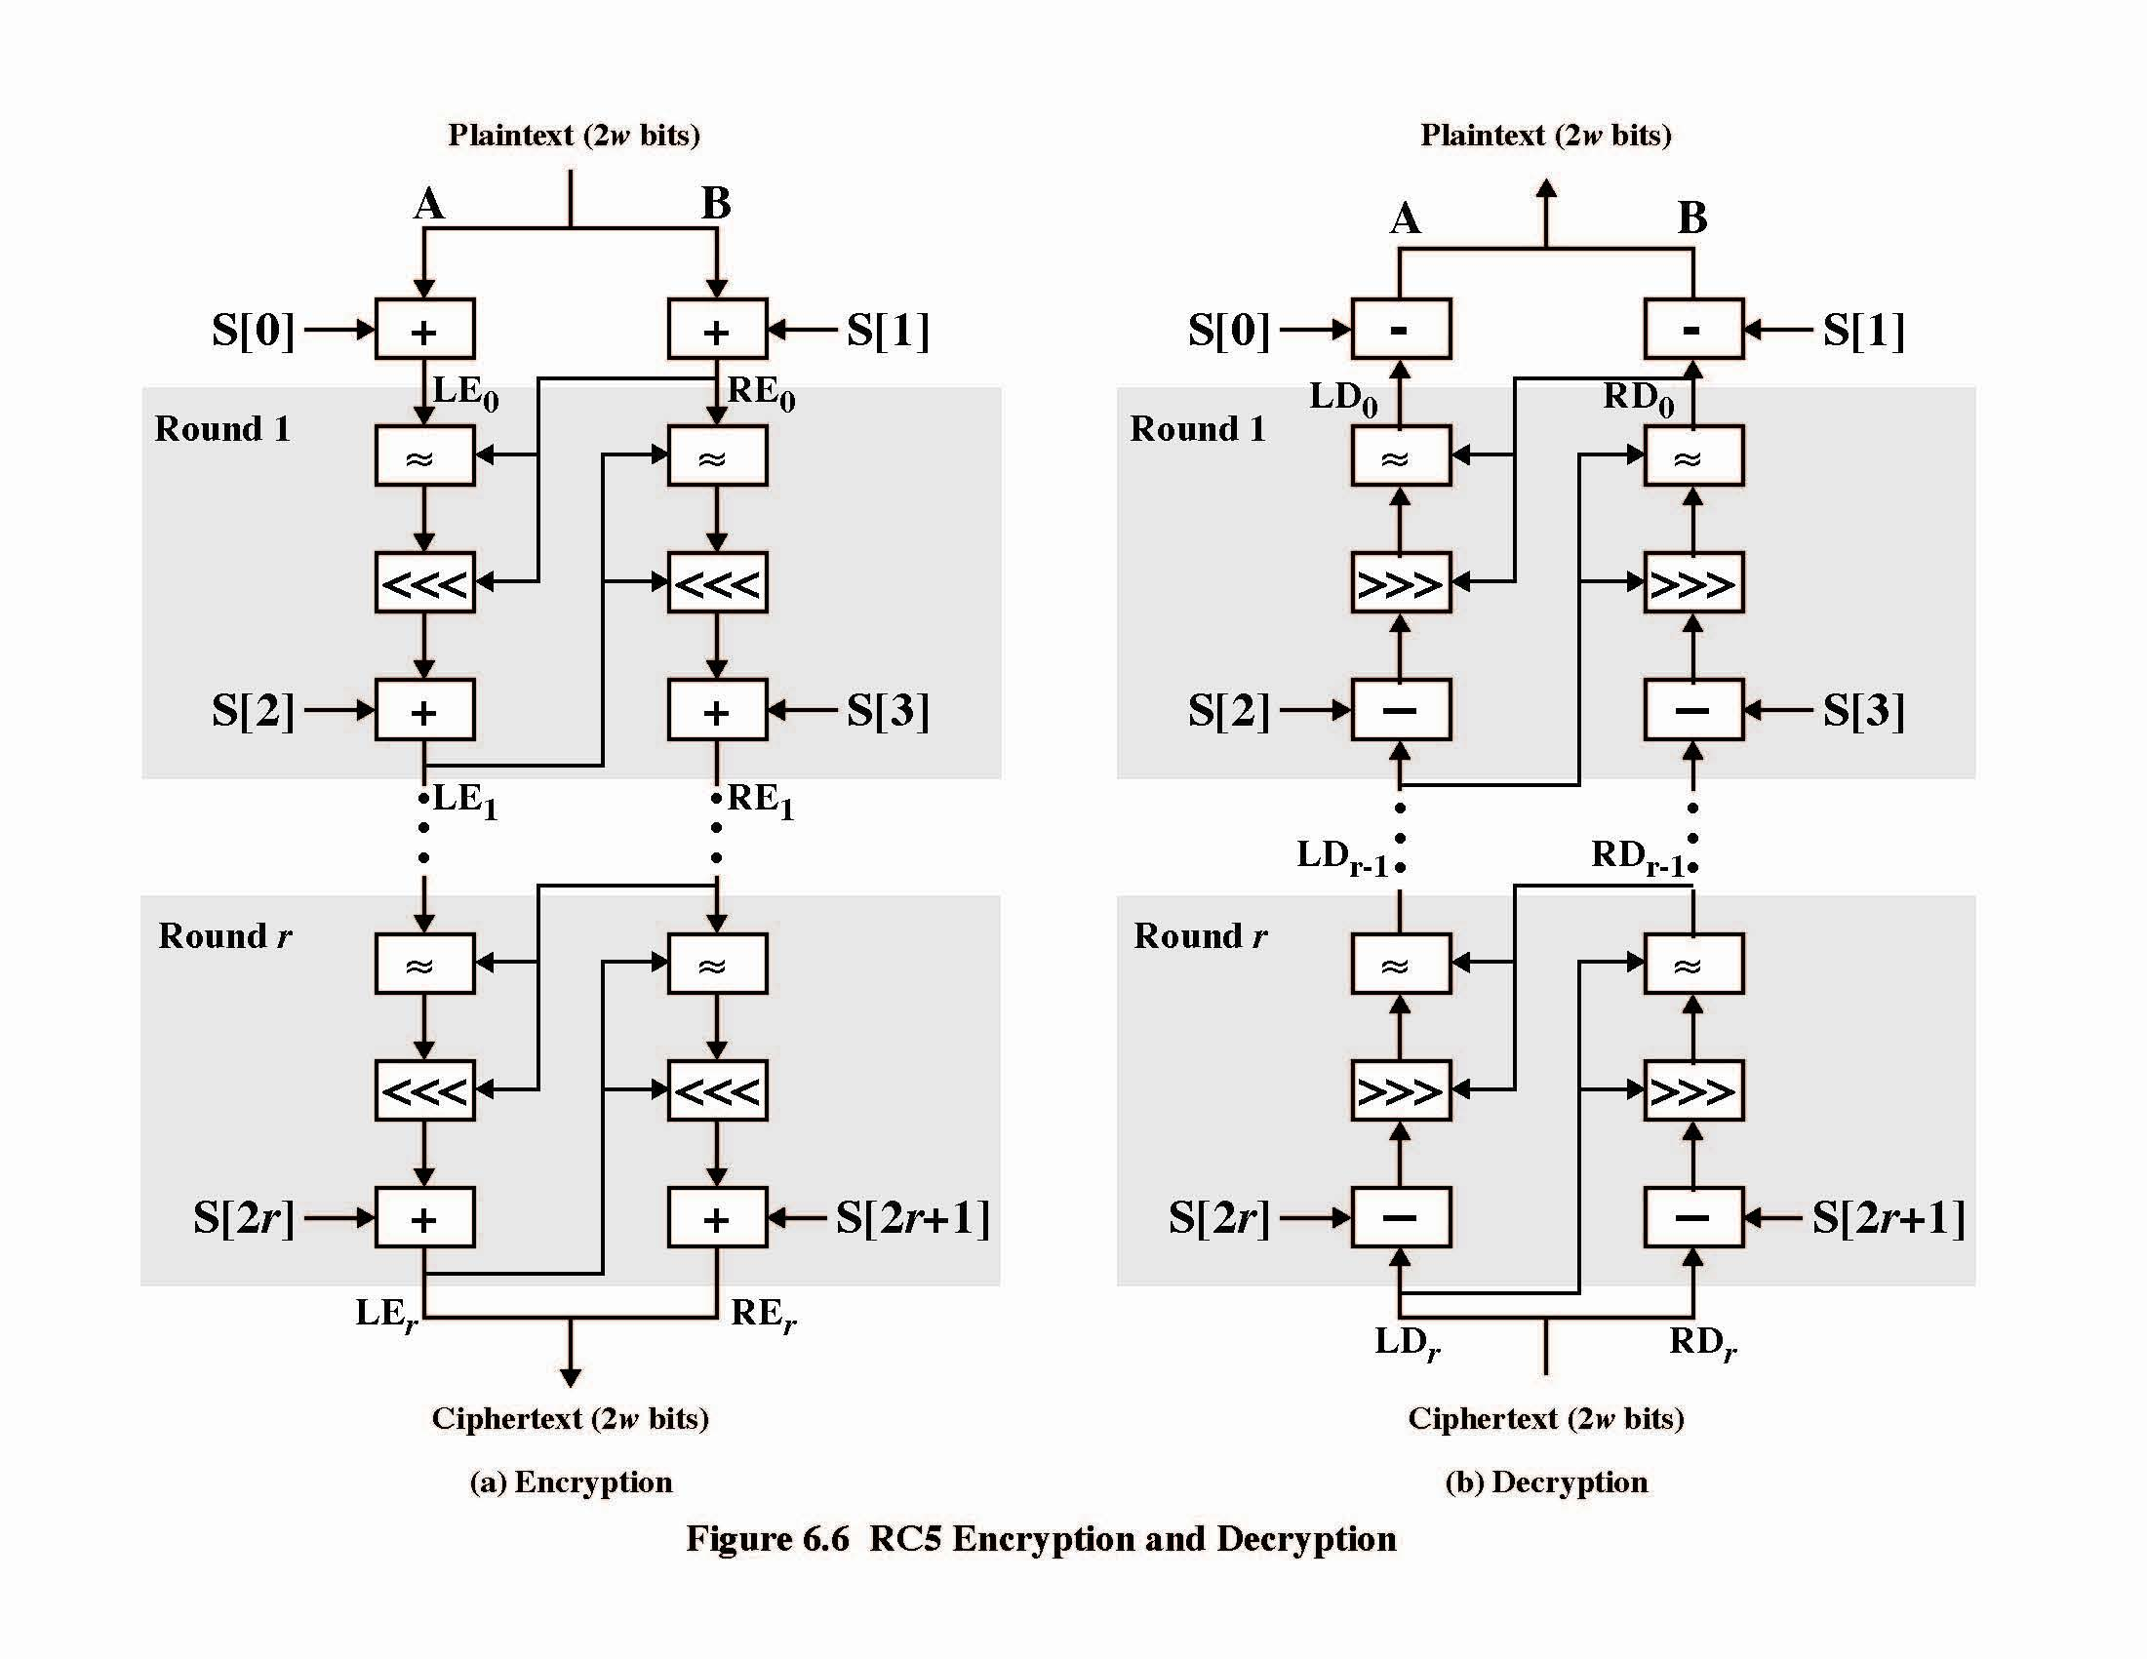
RC5 Encryption & Decryption

Slide 12
RC5 Encryption
split input into two halves A & B
L₀ = A + S[0];
R₀ = B + S[1];
for i = 1 to r do
L_{i} = ((L_{i-1} XOR R_{i-1}) <<< R_{i-1}) + S[2 x i];
R_{i} = ((R_{i-1} XOR L_{i}) <<< L_{i}) + S[2 x i + 1];
each round is like 2 DES rounds
note rotation is main source of non-linearity
need reasonable number of rounds (eg 12-16)
Striking features: simplicity, data-dependent rotations

Slide 13
Agenda
Introduction
RC5
Ciphers
Key Expansion
Encryption & Decryption
Modes
Block & Stream cipher
RC4
Summary
Test your understanding
References

Slide 14
RC5 Modes
RFC2040 defines 4 modes used by RC5
RC5 Block Cipher, is ECB mode
RC5-CBC, input length is a multiples of 2w
RC5-CBC-PAD, any length CBC with padding
Output can be longer than input
RC5-CTS, CBC with padding
Output has same length than input

Slide 15
Agenda
Introduction
RC5
Ciphers
Key Expansion
Encryption & Decryption
Modes
Block & Stream cipher
RC4
Summary
Test your understanding
References

Slide 16
Block Cipher Characteristics
features seen in modern block ciphers are:
variable key length / block size / no rounds
mixed operators
data/key dependent rotation
key dependent S-boxes
more complex key scheduling
Lengthy key generation, simple encryption rounds
operation of full data in each round

Slide 17
Stream Ciphers
process the message bit by bit (as a stream)
typically have a (pseudo) random key stream
combined (XOR) with plaintext bit by bit
randomness of key stream completely destroys any statistically properties in the message
C_{i} = M_{i} XOR StreamKey_{i}
what could be simpler!!!!
but must never reuse key stream
otherwise can remove effect and recover messages

Slide 18
Block/Stream Ciphers
Stream ciphers
For applications that require encryt/decryt of a stream of data
Examples: data communication channel, brower/web link
Block ciphers
For applications dealing with blocks of data
Examples: file transfer, e-mail, database
Either type can be used in virtually any application

Slide 19
Stream Cipher Properties
some design considerations are:
long period with no repetitions
statistically random
Highly nonlinear correlation

Slide 20
Agenda
Introduction
RC5
Ciphers
Key Expansion
Encryption & Decryption
Modes
Block & Stream cipher
RC4
Summary
Test your understanding
References

Slide 21
RC4
variable key size, byte-oriented stream cipher
widely used (web SSL/TLS between browser and server, wireless WEP)
key forms random permutation of a 8-bit string
uses that permutation to scramble input info processed a byte at a time

Slide 22
RC4 Security
claimed secure against known attacks
have some analyses, none practical
result is very non-linear
since RC4 is a stream cipher, must never reuse a key
Notes:
RC4 is widely used, in SSL for secure web transactions amongst other uses. Currently its regarded as quite secure, if used correctly.

Slide 23
Agenda
Introduction
RC5
Ciphers
Key Expansion
Encryption & Decryption
Modes
Block & Stream cipher
RC4
Summary
Test your understanding
References

Slide 24
Summary
have considered:
some other modern symmetric block ciphers
RC5
RC4

Slide 25
Agenda
Introduction
RC5
Ciphers
Key Expansion
Encryption & Decryption
Modes
Block & Stream cipher
RC4
Summary
Test your understanding
References

Slide 26
Test your understanding
Explain RC5 algorithm in detail.
Explain RC4 algorithm in detail.
What are difference between RC5 & RC4 algorithm.

Slide 27
Agenda
Introduction
RC5
Ciphers
Key Expansion
Encryption & Decryption
Modes
Block & Stream cipher
RC4
Summary
Test your understanding
References

Slide 28
References
1. William Stallings, Cryptography and Network Security, 6th Edition, Pearson Education, March 2013.
2. Charlie Kaufman, Radia Perlman and Mike Speciner, “Network Security”, Prentice Hall of India, 2002.

